Slide 1
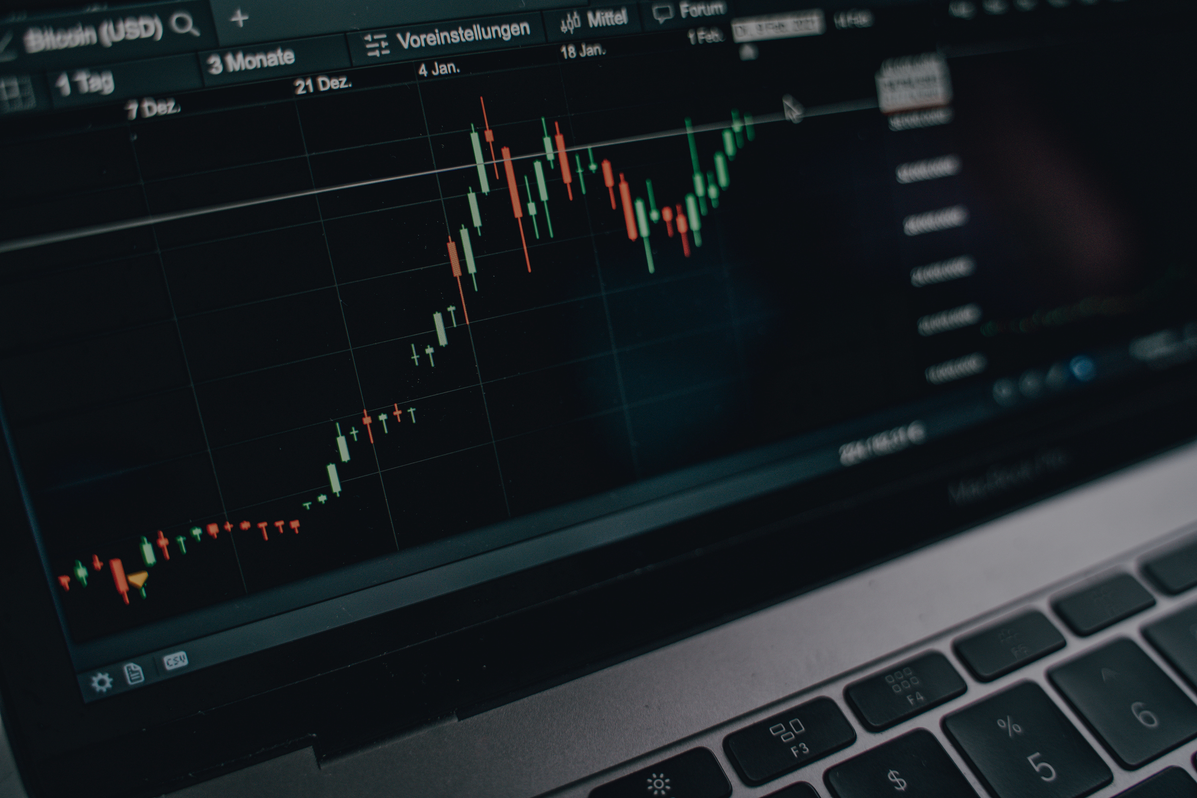

SPRINT 3
PORYGON
The Objective: The goal is to provide an Interactive Web Interface for developing, backtesting and analyzing FOREX algorithmic trading strategies with integrated data visualization, anomaly detection and version control capabilities.

Slide 2
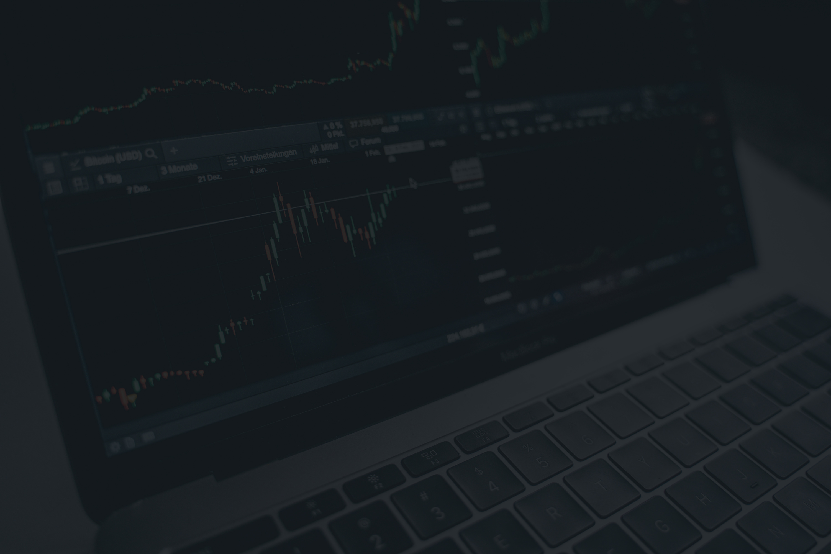
MEET OUR EXPERT TEAM
David Genders (25935410) -> Backend Development
Amir Patel (26034670) ->Backend Development
Shani Van Heerden (26084031) ->Frontend Development
Shalome Neethling (24560502) ->Frontend Development
Rohan Naidoo (26130432) ->Frontend Development
Jamie Smith (24810517) ->Backend Development

Slide 3
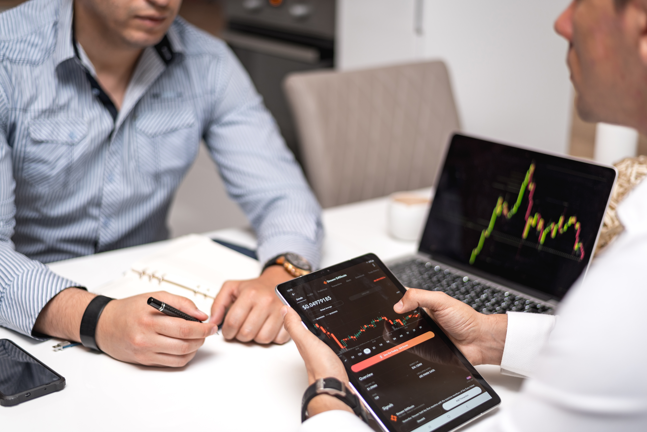
AGILE PROCESS:
PLANNING PHASE:
DEVELOPMENT PHASE:
TESTING PHASE:
REVIEW PHASE:
Gathered and prioritized tasks based on user stories and team suggestions to ensure a clear focus on key deliverables.
Updated test cases were introduced to ensure high-quality performance and early identification of any potential issues.
Completed features were demonstrated to the stakeholders, and feedback was gathered for continuous improvement. We also reflected on areas to enhance in future development cycles.
Focused on implementing new features, such as anomaly detection and user interface refinements, while maintaining continuous collaboration and iterative feedback loops.

Slide 4

ENHANCEMENTS BASED ON CLIENT FEEDBACK:
1. Progress Bar for Backtesting Processes:
Introduced a visual progress indicator to track the duration of backtesting operations.
This lead to better real-time feedback on the status and remaining time of ongoing backtests, offering greater transparency and improving the overall user experience by allowing them to monitor the process more effectively.
2. Asynchronous Data Updates:
Implemented asynchronous data fetching to enable real-time updates on the platform without requiring page reloads.
Significantly enhances the fluidity of the trading experience by providing users with instant feedback and continuously updated information, allowing them to stay informed and respond promptly to market changes.
3. Historical Change Tracking:
To support strategy optimization, we developed a feature that logs and displays the history of changes made to Python scripts over time.
This functionality helps users track modifications to their backtesting strategies, promoting better decision-making and deeper insights into the evolution of their approaches.
It also enables users to easily review and analyze previous iterations for improved strategy development.

Slide 5
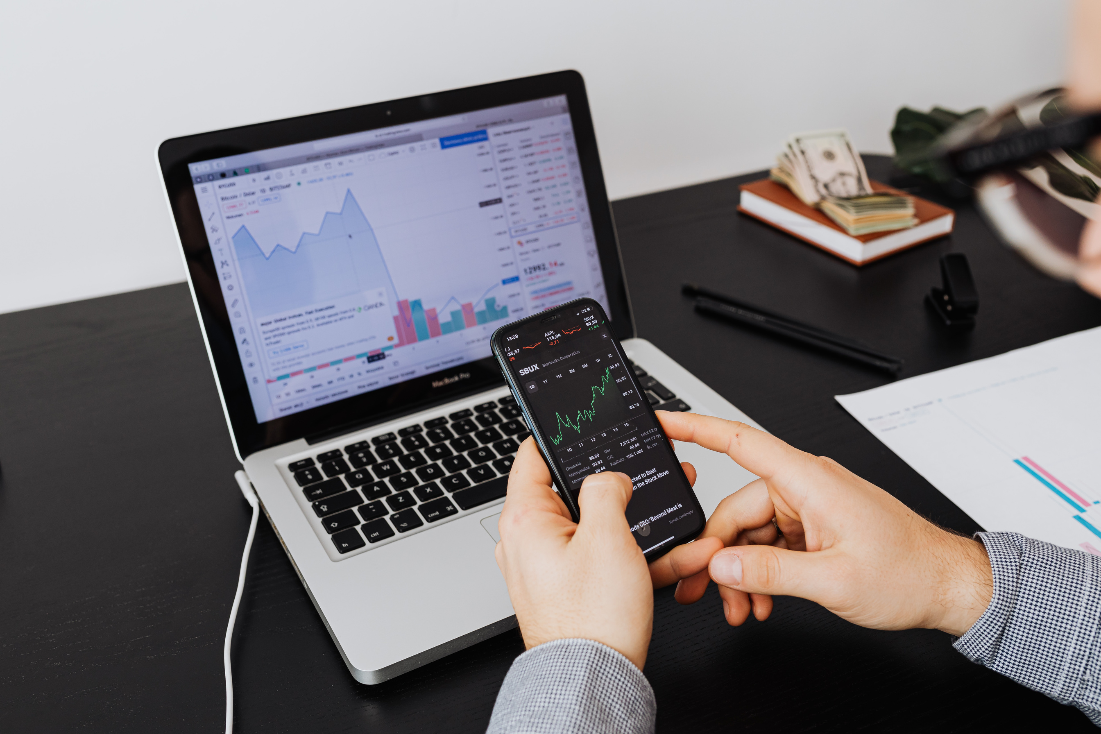
ENHANCEMENTS BASED ON THE DEMI'S RECOMMENDATIONS:
01
COMPREHENSIVE DOCSTRINGS:
·In-line documentation has been incorporated across all Python files.
This ensures that functions, classes, and modules are well-documented, enhancing code readability and improving maintainability.
The clear descriptions of each component’s purpose and functionality make it easier for developers to navigate and understand the implementation.
02
BUTTON COLOR SCHEME UPDATE:
$. 608.00.896.789.900
+23487.09
The button color scheme has been refined to provide a more visually appealing and user-friendly interface.
This update was carefully applied to ensure consistency across newly designed pages, maintaining a cohesive and professional aesthetic throughout the entire website.
$. 708.006.789.859.77
-13487.09
$. 567.345.678.123.
-487.09

Slide 6

IMPROVEMENTS BASED ON TEAM SUGGESTIONS:
ANOMALY DETECTION:
UPDATED TEST CASES:
The anomaly detection feature has been enhanced to more effectively identify unusual patterns and outliers in trading data.
It is now showcased on a dedicated webpage, offering users easy access to insights and a clearer interpretation of detected anomalies, improving their decision-making processes.
The test cases have been thoroughly refined to improve application reliability, ensuring that it functions as expected and effectively identifies potential issues early. This enhancement strengthens overall code quality, contributing to a more robust and dependable platform for users.

Slide 7

THANK
YOU
Now for the live demonstration!

